Slide 1
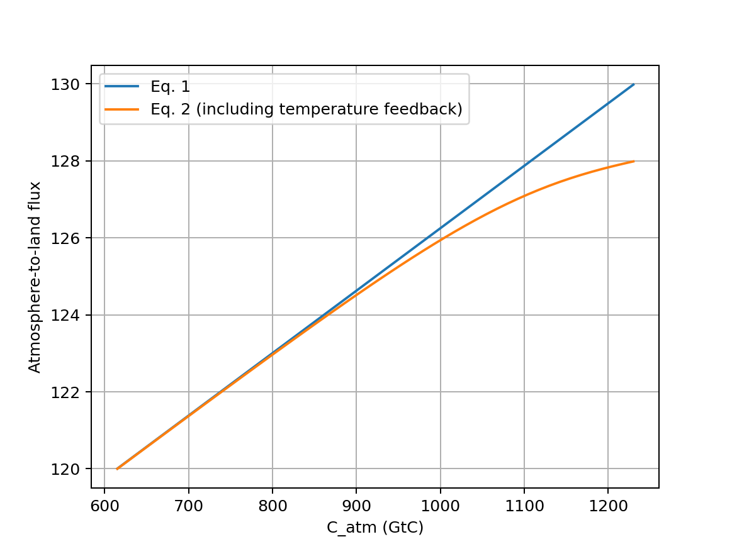


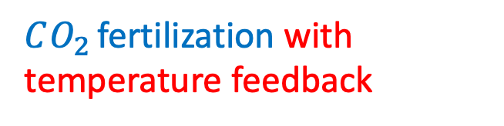
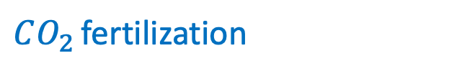
In AdaptiveFlows, we figured out how to represent temperature-dependent atm->land flux
$CO_{2}$ fertilization
$CO_{2}$ fertilization with temperature feedback

Slide 2
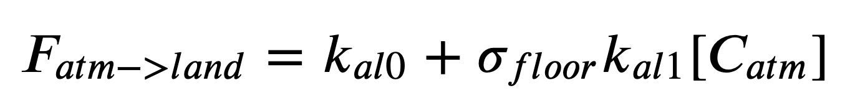
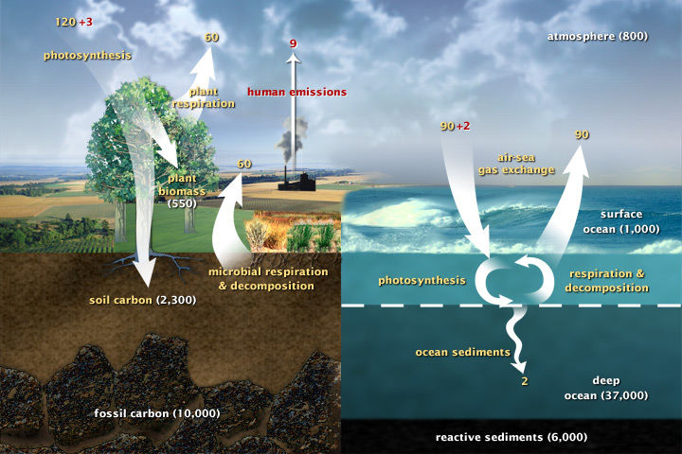
In AdaptiveFlows, we figured out how to represent temperature-dependent atm->land flux
So … that’ll be a Cambio2.0 innovation!

Slide 3

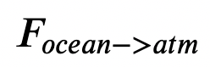

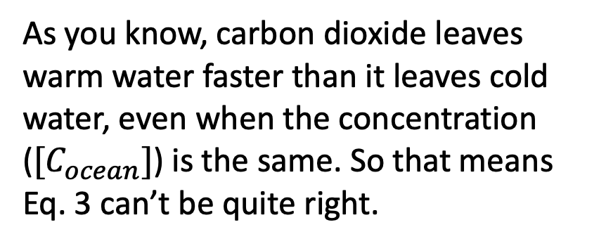
Another limitation: temperature dependence of the ocean->atmosphere flux
As you know, carbon dioxide leaves warm water faster than it leaves cold water, even when the concentration ($[C_{ocean}]$) is the same. So that means Eq. 3 can’t be quite right.
Cold ocean
Warm ocean
So … that’ll be another Cambio2.0 innovation!

Slide 5
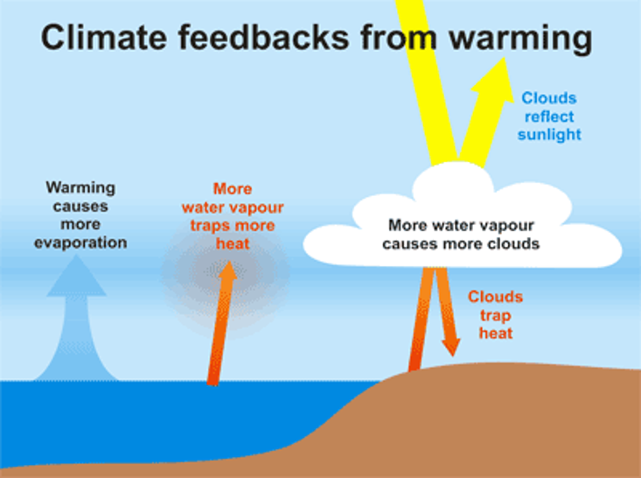
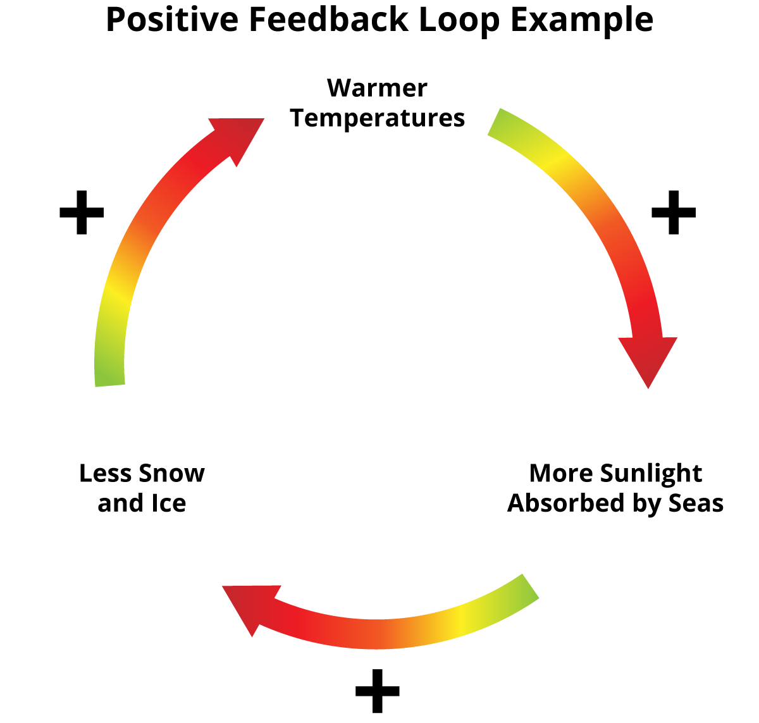
Diagnostic variables can become prognostic if we code in feedbacks
Parametric variables
Specified outside the Euler loop
Could be constant or time-dependent
Prognostic variables
Appear on the left-hand-side and the right-hand-side of assignments in the loop (i.e., calculated and used to calculate other variables)
Diagnostic variables
Appear on the left-hand-side of assignments in the loop, but not on the right-hand-side (i.e., they’re calculated, even graphed, but not otherwise used)
Temperature <-> cloud-albedo feedback was wishful thinking -- it’s not happening
Temperature <->
ice-albedo feedback
really is happening in real life (although not in Cambio1.1)

Slide 6
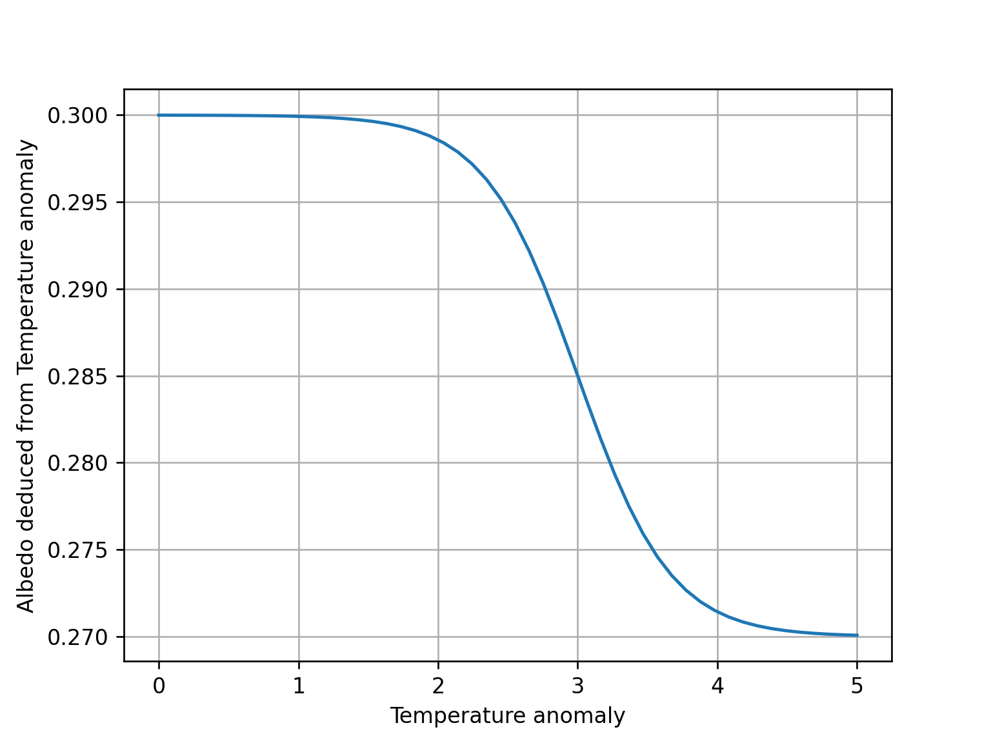
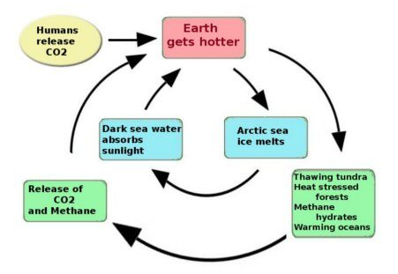
Diagnose_albedo
T_anomaly =>
albedo reduction
Preindustrial albedo is 0.3
Preindustrial albedo is 0.3
Albedo can’t drop faster than 0.0005/year
Albedo can’t drop faster than 0.0005/year
Bottoms out at 0.27
Bottoms out at 0.27
In 2005, the CERES Science Team reported Earth’s shortwave albedo had been steadily declining at a rate of 0.0006/year, based on four years of measurement (earthobservatory.nasa.gov/images/5484/earths-albedo-in-decline). In comparison,
Our maximum of 0.0005/year is more conservative than 0.0006/year
0.0006/year would lower albedo to 0.27 by 2050 or so

Slide 7
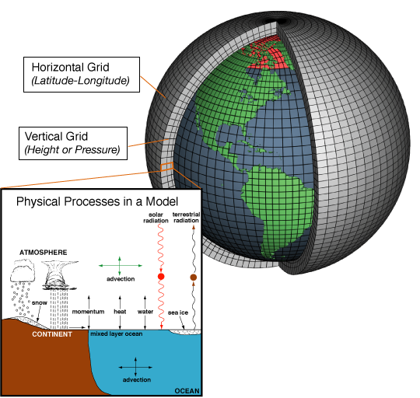
Do we have the right amplification mechanisms?

Slide 8
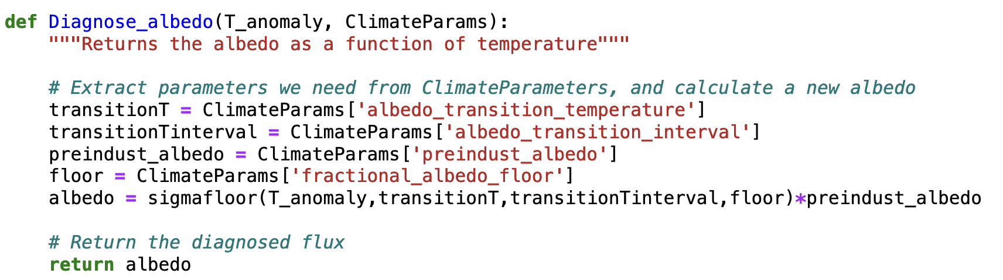
Diagnose_albedo
T_anomaly =>
albedo reduction
Preindustrial albedo is 0.3
Transition temperature:
½ -complete when T_anomaly is +3ºC
Transition Interval: about 1ºC to go from 80% to 20%
Floor: bottoms out at 0.27

Slide 9
Diagnose_albedo
T_anomaly =>
albedo reduction
Preindustrial albedo is 0.3
Transition temperature:
½ -complete when T_anomaly is +3ºC
Transition Interval: about 1ºC to go from 80% to 20%
In 2005, the CERES Science Team reported Earth’s shortwave albedo had been steadily declining at a rate of 0.0006/year, a rate that would lower albedo to 0.27 by 2050 or so.
Floor: bottoms out at 0.27
earthobservatory.nasa.gov/images/5484/earths-albedo-in-decline

Slide 10
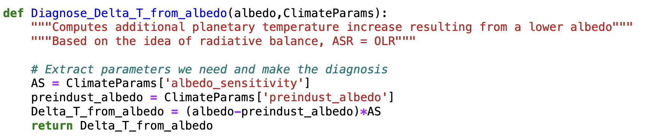
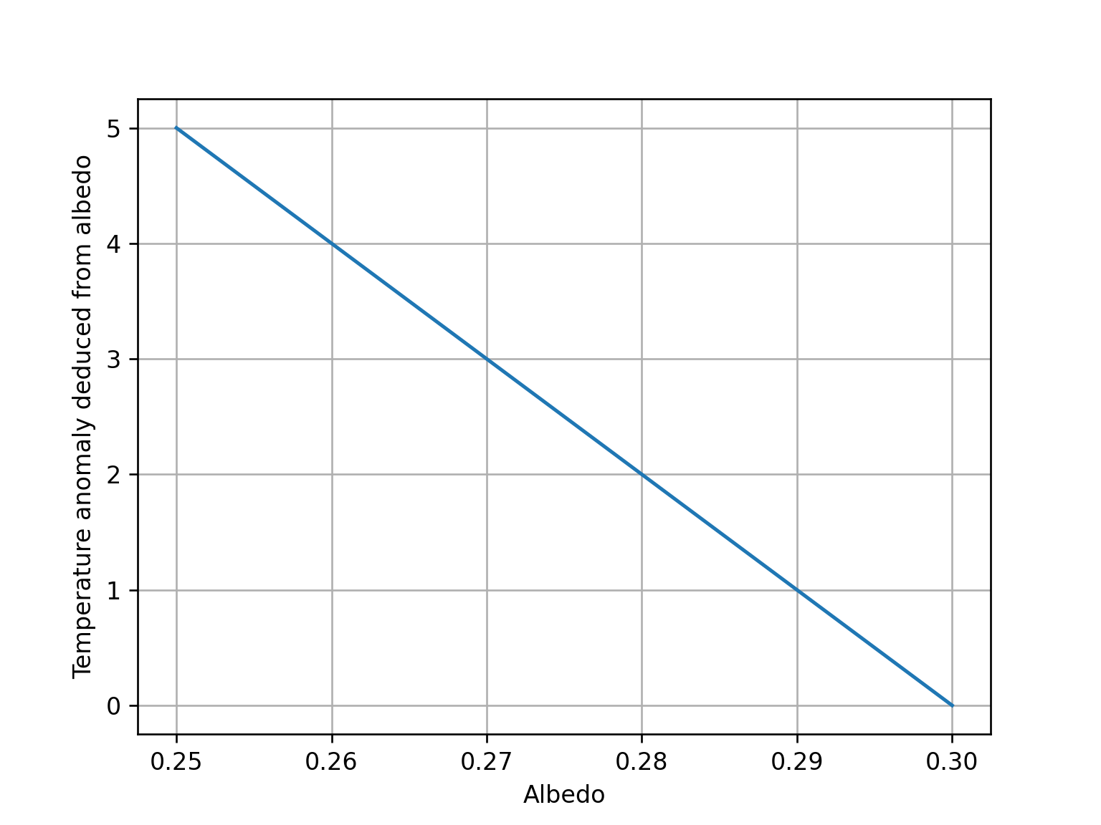
Diagnose_Delta_T_from_albedo
Albedo reduction => T_anomaly
Temperature is high when albedo is low
Our radiative balance modeling earlier said every reduction of 0.01 in albedo will lead to +1ºC.
Temperature is low when albedo is high

Slide 11
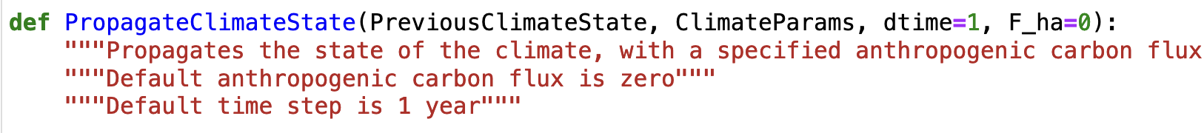
Taken together, this constitutes a feedback loop
As implemented in PropagateClimateState
...
...

